Slide 1

Biomedical Waste
An Overview
Gina Vallone-Hood, CEHP
Bureau of Environmental Health

Slide 2

Biomedical Waste Law and Rules
Section 381.0098, Florida Statutes (FS)
Chapter 64E-16, Florida Administrative Code (FAC)
DOH Authority:
  Onsite
  Segregation
  Packaging
  Storage
  Transfer
  Treatment (other than incineration*)
Offsite
  Transport
  Storage
  Treatment (other than incineration*)
  *Incineration under DEP

Slide 3
Statutory Language
Interagency Agreement with
Florida Department of Environmental Protection
Preemption of Authority
to Regulate Generators
No local ordinances

Slide 4
Classification & Licensing
Generator – Produces biomedical waste
  Permit or Exemption
Transporter – Transport biomedical waste away from the point of generation to a storage or treatment facility
  Registration of transport vehicles
Storage Facility – Stores biomedical waste at a location other than the point of generation
  Permit
Treatment Facility – Commercial location that treats biomedical waste
  Permit

Slide 5
Chapter 64E-16, FAC
Does Not Apply To:
Linen that is to be laundered and reused
Transport of bodies, parts of bodies, or tissue specimens for lawful examination, investigation or autopsy pursuant to section 406.11, F.S.
Dead human bodies that are disposed of by a person under the provisions of Chapter 470, F.S.
Testing or research specimens
Farm operations and agricultural businesses*
Notes:
The rule is very specific to what is not regulated as biomedical waste. This includes linens, since these items are reusable they don’t fall under this regulation. Often times you will find dirty linens stored in red bags. This is not a recommended practice because it can cause confusion within the generating facility. If you come across this situation, you may want to explain that a red bag should be used only for things that are thrown away, not for items that are going to be removed from the bag and reused.
This rule also does not apply to the transport of bodies, body parts, or tissue specimens that would be used for investigation or autopsy. Dead human bodies are not considered biomedical waste; they are covered under Chapter 470, F.S., which pertains to funeral homes. Additionally, specimens that are used for testing or research are not considered biomedical waste until they are ready to be disposed.

Slide 6

What is Biomedical Waste?
Any solid or liquid waste which may present a threat of infection to humans, including:
  nonliquid tissue, body parts,
  blood, and blood products from
  humans and other primates;
  lab and veterinary wastes which
  contain human disease-causing
  agents; and
  discarded sharps.

Slide 7

What is Biomedical Waste?
Body fluids which have the potential to harbor pathogens such as HIV and HBV
semen
vaginal
lymph
pleural
cerebrospinal
peritoneal
pericardial
amniotic
synovial
urine
feces
saliva
tears
vomit
nasal discharges
sweat
Notes:
Body fluids were mentioned earlier when we discussed the absorbent and non-absorbent materials. Body fluids include semen, vaginal, and lymph fluids. Peritoneal fluid, which comes from the peritoneum, which lines the abdomen. Synovial fluid, which is found around joints. Pericardial fluid, which surrounds the heart. Pleural fluid, which is found in the cavity that surrounds the lungs, and cerebrospinal fluid, which is found in the central nervous system: the brain and spinal cord.

Slide 8
INCLUDES:
Used, absorbent materials saturated with blood, blood products, body fluids, or excretions or secretions contaminated with visible blood, and absorbent materials saturated with blood or blood products that have dried
Non-absorbent, disposable devices that have been contaminated with blood, body fluids or secretions or excretions visibly contaminated with blood, but have not been treated by an approved method

Slide 9
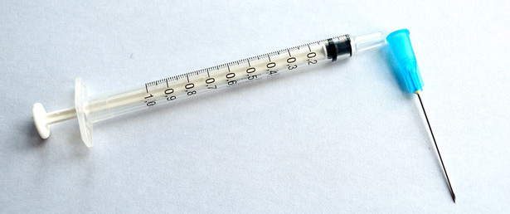
What is Biomedical Waste?
Any solid or liquid waste which may present a threat of infection to humans, including:
Veterinary Waste
Animals (tissue and blood) with zoonotic disease
All needles and needles with syringes attached
Notes:
Veterinary Waste consist of needles, scalpels, and animals with human disease causing agents, such as rabies. Vaccine bottles from live or attenuated vaccines, such as parvo and distemper are also biomedical waste. Animal body parts from healthy animals, those that don’t have a zoonotic disease, are considered solid waste.

Slide 10
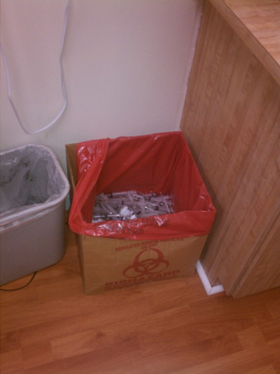
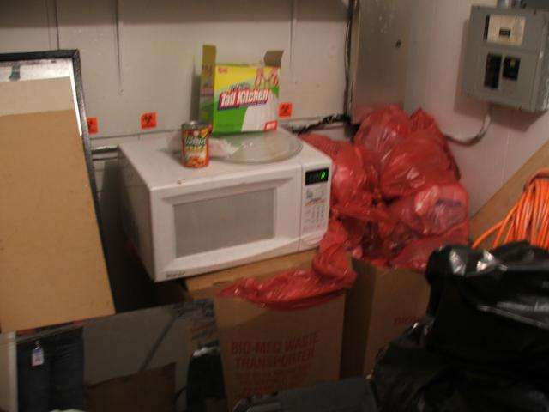
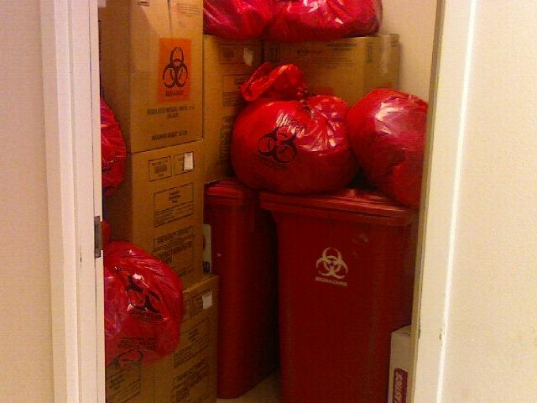
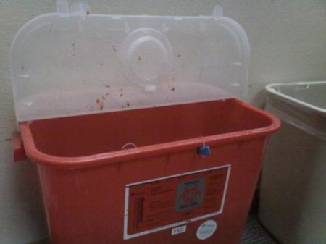
Additional Requirements
Include:
Segregation at point of origin
Red bag and outer container specifications
Labeling
Storage
Notes:
Packages of biomedical waste must be labeled in accordance with the code. The code specifies that the exterior of all bags and sharps containers be labeled with the generator’s name and address, unless treatment occurs at the generating facility. Most facilities will place the smaller red bags and sharps containers into a larger bag, when this practice is followed, they must only label the exterior of the larger red bag with the facility’s name and address. The labeling can be accomplished by using a permanent marker and handwriting the information, using sticky labels, such as return address labels, or taping a business card onto the bag. If the facility chooses to use the business card, discourage them from using a stapler; the staples will compromise the integrity of the bag.
In a situation where you have generator’s sharing a transport box, each package of biomedical waste that is placed into the transport box must be labeled with that particular generator’s name and address, and the exterior of the red bag that lines the transport box should be labeled with the name and address of the individual that is named on the transporter’s contract.
Transport containers must be labeled with the transporter’s name, address, 24-hour phone number, and DOH registration number. These boxes can be labeled with a bar code that contains this information. Generally you will find that cardboard transport boxes are preprinted with the biohazard symbol, phrase, and transporter information. If you ever come across plain transporter boxes or boxes with a different transporter’s information, it is important that you find out if the transporter is labeling these boxes with the required information prior to transport. Questions have been asked about who’s responsibility it is to ensure compliance with the labeling. The generator is held responsible for meeting the labeling requirement. Often times they will assume that the transporter is labeling the bag that lines the transport container, but very few transporters offer this service. The generator and the transporter are both responsible for the labeling of the exterior of the transport container. Some transporter use reusable, plastic containers; the labels can come off of these containers during the decontamination process that is done after each use.

Slide 11
Biomedical Waste Transporters
Vehicle requirements:
  Registration
  Labeling
    Business name
    24-hour phone number
    DOH registration number
    Placard with phrase and 6” biohazard symbol
  Fully enclosed
  Impermeable interior
  Secured when unattended
  Written operating plan
  Spill kit
Notes:
Commercial biomedical waste transporters must meet the following requirements:
Each vehicle that is used to contain the biomedical waste must be registered with the department; this includes trailers.
The exterior of each vehicle that is used to contain the biomedical waste must be labeled with the business name, 24-hour phone number, registration number, and placarded with the 6” biohazard symbol and phrase.
The vehicle containing the biomedical waste must be fully enclosed and the interior should be fabricated of impermeable surfaces. Therefore, if the interior of the truck is composed of wood, they should then seal the wood to ensure that it is nonporous.
The area of the vehicle that contains the biomedical waste must be capable of being secured when the vehicle is unattended.
Each vehicle should have a copy of the registration, written operating plan, and spill kit.

Slide 12
Treatment
Biomedical waste shall be treated by steam, incineration, or other method suitable for hazard inactivation which is acceptable to the Department.
Biomedical waste incineration facilities are under the purview of DEP.
Notes:
Let’s discuss treatment. Biomedical waste shall be treated by steam, incineration, or any other method suitable for hazard inactivation. Currently, all treatment processes, other than steam autoclaves, must be approved by the department prior to use in Florida. Process approval is conducted by HQ. Once a process has been approved, they are added to the Approved Alternative Treatment List that is posted on SharePoint in the Shared Documents folder. Generators may treat their own biomedical waste utilizing one of the approved treatment processes and are not required to obtain a treatment permit. If a generator chooses to treat their own biomedical waste, they should notify the CHD inspector to learn of any specific protocols. Anyone wishing to open a commercial treatment facility must apply and obtain a permit from the department; this includes any generator that chooses to treat biomedical waste generated by other generators.

Slide 13
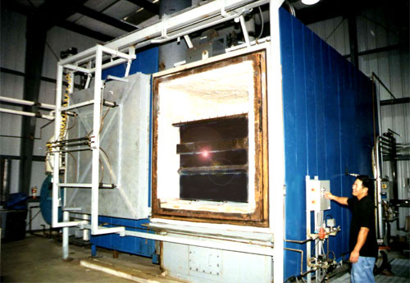
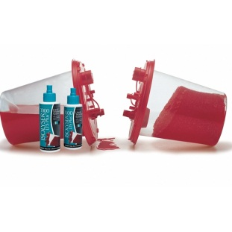
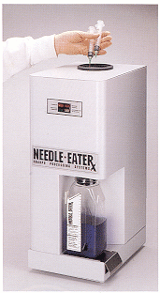
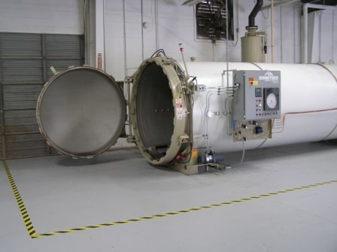
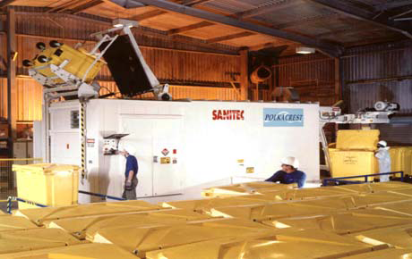
Treatment Processes
Alkaline Hydrolysis
Chemical
Pyrolysis
Heat
Steam Autoclave
Microwave

Slide 14
Biological vs. Biomedical
ss. 62-701.200(9), FAC
Biological waste means solid waste that causes or has the capability of causing disease or infection and includes biomedical waste, animals that died from disease, and other wastes capable of transmitting pathogens to humans or animals.
ss. 381.0098(2)(a), Florida Statutes (FS)
Biomedical waste means any solid or liquid waste which may present a threat of infection to humans. The term includes, but is not limited to, nonliquid human tissue and body parts; laboratory and veterinary waste which contains human-disease-causing agents; discarded disposable sharps; human blood, blood products, and body fluids; and other materials which in the opinion of the department represent a significant risk of infection to persons outside the generating facility.

Slide 15
Biological vs. Biomedical
ss. 62-701.520(5), FAC - Biological waste disposal
(a) Disposal of bodies of domestic animals, upon the death of such animals due to disease, shall be accomplished pursuant to Section 823.041(1), F.S. This provision does not prohibit the disposal of such animals in Class I landfills.
(b) Disposal of dead poultry and hatchery residue shall be accomplished pursuant to Section 583.181(2), F.S.
(c) Bodies of captive wildlife, as well as bodies of domestic animals that have not died due to disease, may either be used, burned, disposed of in a Class I landfill, or disposed of on the property where they died provided they are buried at least two feet below the surface of the ground and above the water table.
(d) Biomedical waste that has been treated may be disposed of as solid waste that is not biomedical.
ss. 381.0098(2)(e), FS – Treatment of biomedical waste
Treatment is any process, including steam treatment, chemical treatment, and microwave shredding, which changes the character or composition of biomedical waste so as to render it noninfectious. For the purposes of this section, treatment does not include the incineration of biomedical waste.

Slide 16
Other Regulations
49 CFR - Chapter I, subpart 173.134
-Department of Transportation
Infectious Waste
Category A
An infectious substance in a form capable of causing permanent disability or life-threating or fatal disease in otherwise health humans or animals when exposure occurs.
Category B
An infectious substance that is not in a form generally capable of causing permanent disability or life-threatening or fatal disease in otherwise healthy humans or animals when exposure to it occurs.

Slide 17
Gina Vallone-Hood
(850)245-4273
gina_vallone@doh.state.fl.us
Israel Juarbe, Jr.
(850)245-4444 ext. 2336
israel_juarbejr@doh.state.fl.us

